Slide 1
Session 4
MDI Applications

Slide 2
Review
Different Print support controls supported by Win Forms are:
  PrintDocument
  PrintPreviewControl
A Dialog box is a temporary window that contains controls to display information or accept choices from use.
Depending on the nature of behavior, a dialog box may be classified as: Modal and Modeless
OpenFileDialog : Used to open files.
PageSetUpDialog : Used to set the Page options such as Paper size, Left margin and Right margin.
FontDialog : Used to specify the font specifications such as the font name, size and color.

Slide 3
Review Contd…
ColorDialog : Used to select a color. Displays a wide variety of colors and allows us to select from those displayed colors.
SaveFileDialog : Used to specify the filename and save files.
PrintPreviewDialog : Used to view how the document would look after printing.
PrintDialog : Used to set print specifications such as number of copies, the printer and what is to be printed.
The MessageBox dialog is used to display messages.
Some of the Visual Effects supported in WinForms :
  Transparent Forms
  Control Docking
  Control Anchoring
  Visual Inheritance

Slide 4
Objectives
Differentiate between SDI and MDI
Create an MDI application
Create Menus and Menu Components
Discuss the ToolBar and StatusBar controls
Create User defined dialog boxes

Slide 5
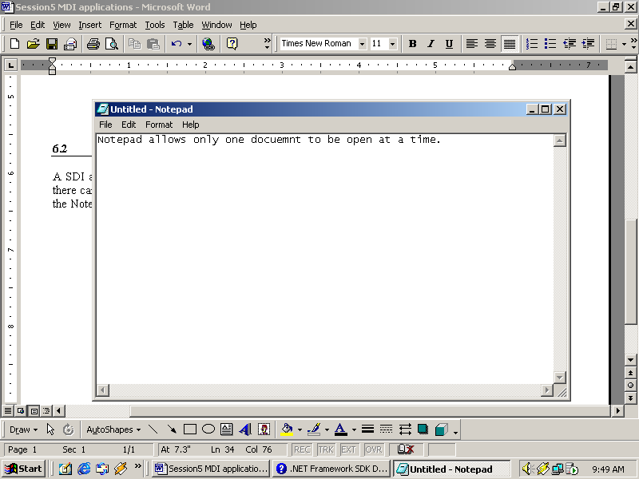

SDI
Closed
File→New
Document
An SDI application can have only one active window at a time
Active Window

Slide 6
Drawbacks of using SDI
Cannot handle multiple forms at the same time
Multiple copies of the application have to be opened to handle multiple forms at the same time

Slide 7


MDI
MDI applications group multiple documents as a single unit
Multiple documents
A window is the base for all interfaces
MDI applications handle multiple windows simultaneously

Slide 8
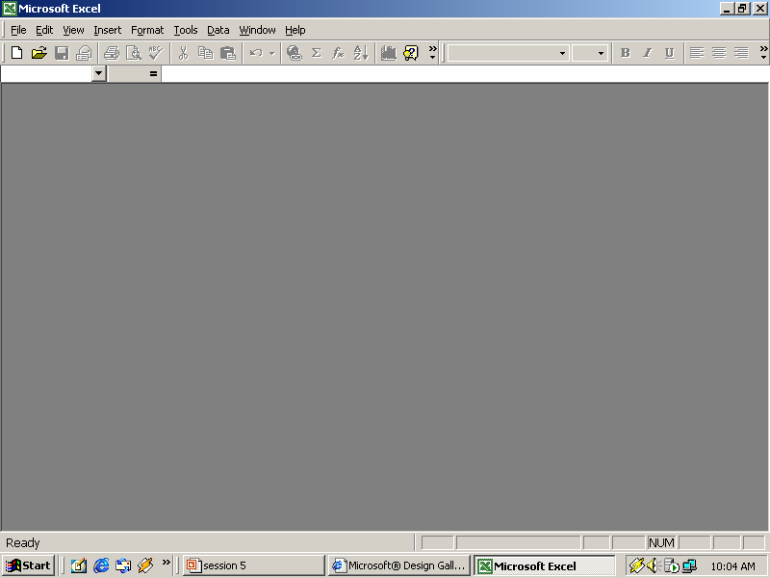
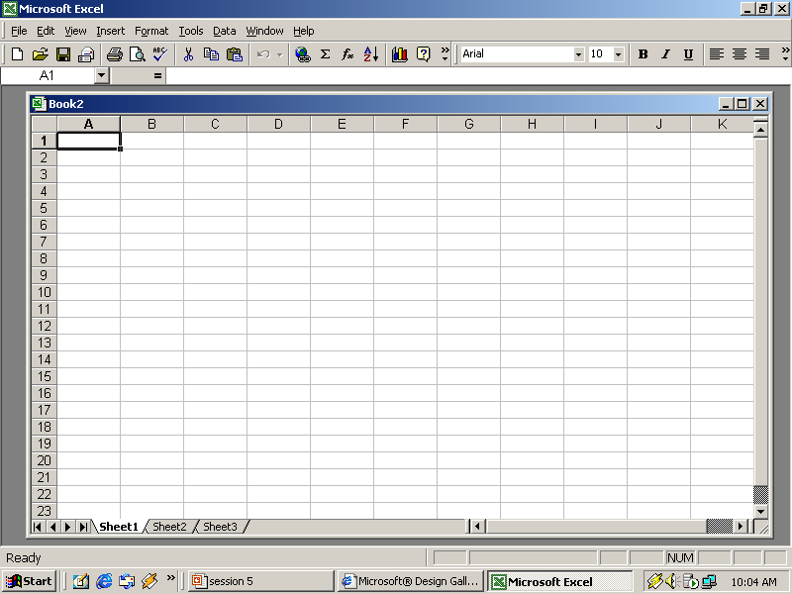
MDI Contd…
New
Document
Outer Window (or)
Parent Window
Inner Window (or)
Child Window

Slide 9
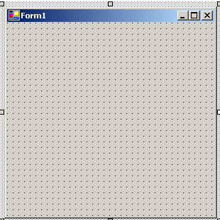
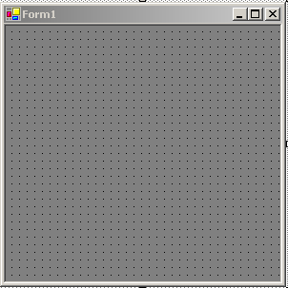
Design an MDI application
Property
= true
IsMdiContainer
To add a child form to the MDI form:
Add a new form
Add the code to call the child form

Slide 10
Characteristics of MDI Components
Features of the Parent Form :
  Displayed as soon as the MDI application is started
  Acts as the container for other windows
  Menus of the child form are displayed on the parent form
  Can be only one MDI parent form in an application
  Multiple child forms can be open at a time

Slide 11
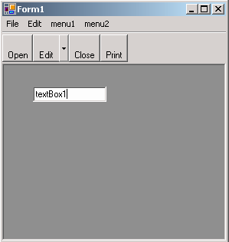
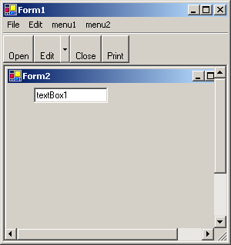
Characteristics of MDI Components Contd…
  The Child forms cannot be moved out of the MDI frame area
  Closing the MDI form automatically closes all open MDI child forms
Child Form
opened
Controls, other than Menus, ToolBar and StatusBar, placed on the MDI form, overlap the child form

Slide 12
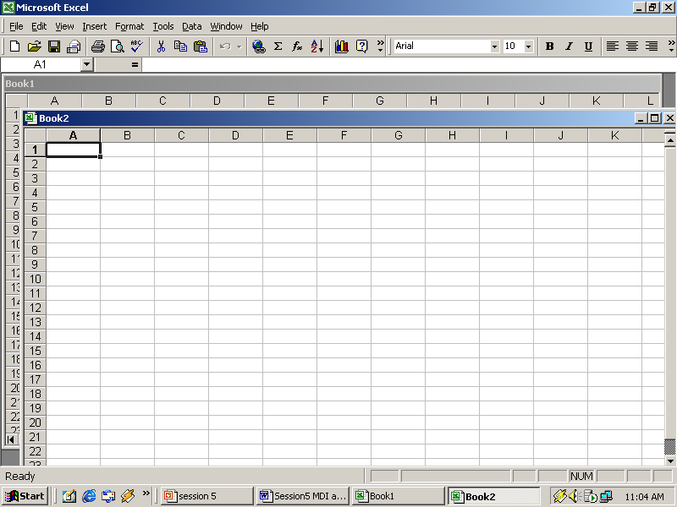
Activating and Deactivating Windows
Inactive child window
Active child window
The topmost window is the Active Window
The color of the title bar of an active window is the same as that of the MDI window

Slide 13
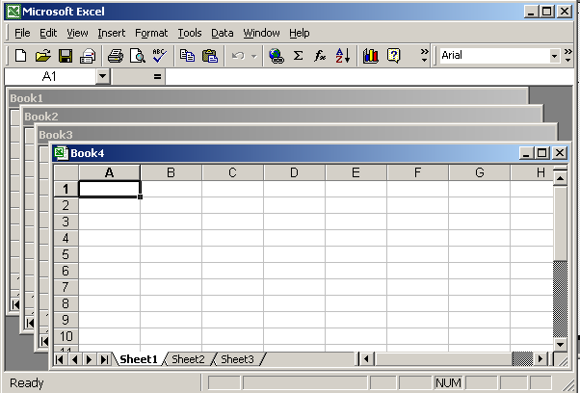
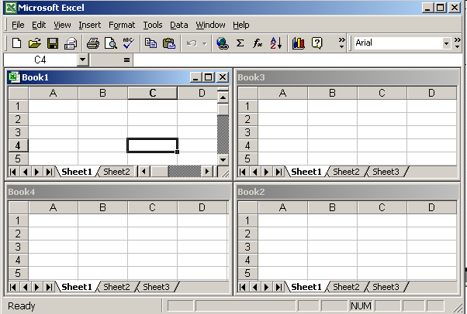
Arranging Child Windows
Cascade
Tile

Slide 14
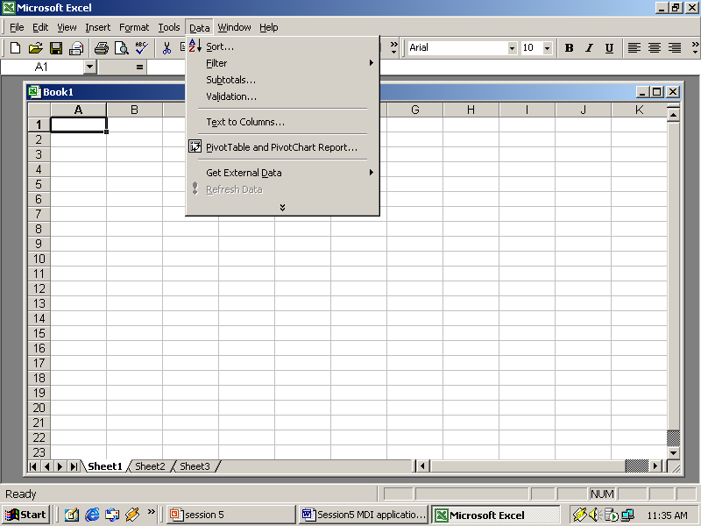
Menus
Menu bar
Sub Menu Option
Main Menu Option

Slide 15
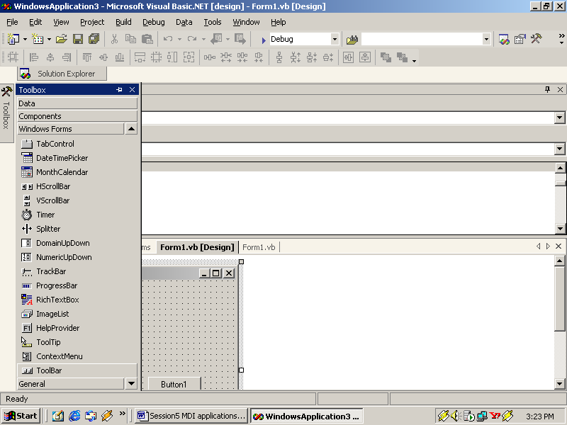
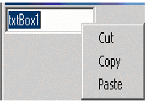
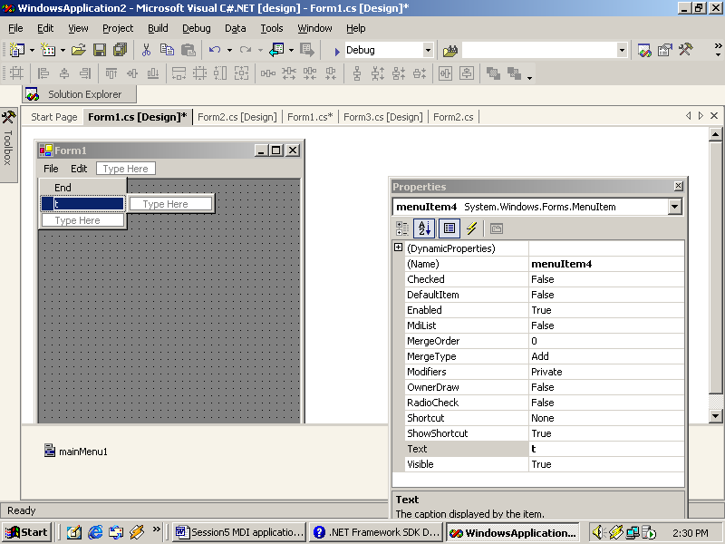
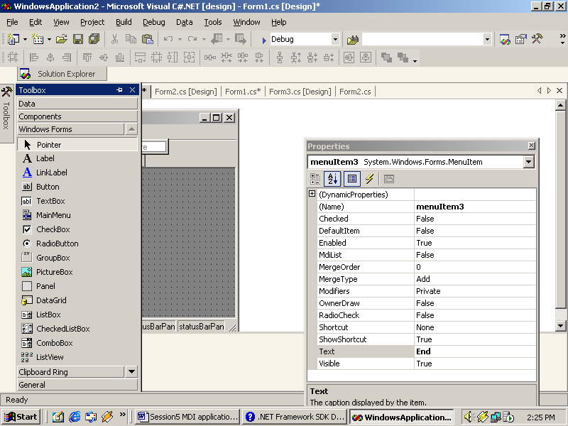
Types of Menus
Types of Menu
Context Menu
Main Menu
As in Toolbox icon
As with the control at run time
As in Toolbox icon
As in MDI form during design

Slide 16
MainMenu Control
Displays a menu at run time
Main menu can be created in two ways:
1
MainMenu control and menu designer at design time
MainMenu myMainMenu1 = new MainMenu(); this.Menu = myMainMenu1;
2
By creating an instance of the MainMenu class at run time

Slide 17
MainMenu Control Contd…
Properties
Methods
MainMenu
GetForm
IsParent
GetContextMenu
MdiListItem
GetMainMenu
MenuItems
MergeMenu

Slide 18
MenuItem
Properties
Methods
Index
Text
ShowShortCut
MenuItem
PerformSelect
Checked
PerformClick
Parent
MdiList
Events
DefaultItem
Click
ShortCut
Popup
Select

Slide 19
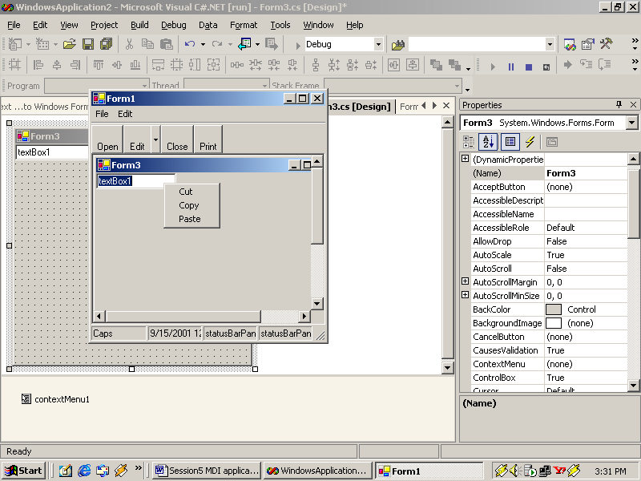
ContextMenu
Gives users access to frequently used commands by clicking the right mouse button.
Following code can be used to create a context menu at runtime and to display it.
ContextMenu ContextMenu1 = new ContextMenu();
this.ContextMenu = ContextMenu1;
The ContextMenu control supports all the properties, methods and events of the MainMenu control

Slide 20
Adding and Removing Menu Items
MainMenu mainMenu1=new MainMenu();
MenuItem addItem = new MenuItem();
MenuItem removeItem = new MenuItem();
addItem.Text = "&Add";
removeItem.Text = "&Remove";
mainMenu1.MenuItems.Add(addItem);
mainMenu1.MenuItems.Add(removeItem);
this.Menu=mainMenu1;
DialogResult preference= new DialogResult();
preference = MessageBox.Show("Do you want to add new Menu Item","Add",MessageBoxButtons.YesNo);
if(Convert.ToString(preference)=="Yes")
{ mainMenu1.MenuItems.Add("New Menu");
DialogResult preference1= new DialogResult();
preference1 = MessageBox.Show("Do you want to delete the new Menu Item","Remove",MessageBoxButtons.YesNo);
if(Convert.ToString(preference1)=="Yes")
{ mainMenu1.MenuItems.RemoveAt(2); } }

Slide 21
Menu-A Programmer’s Viewpoint
A menu is a control
There is no standard “look” associated with a menu
A name is associated with each menu item
The name is specified at the time of creating the menu

Slide 22
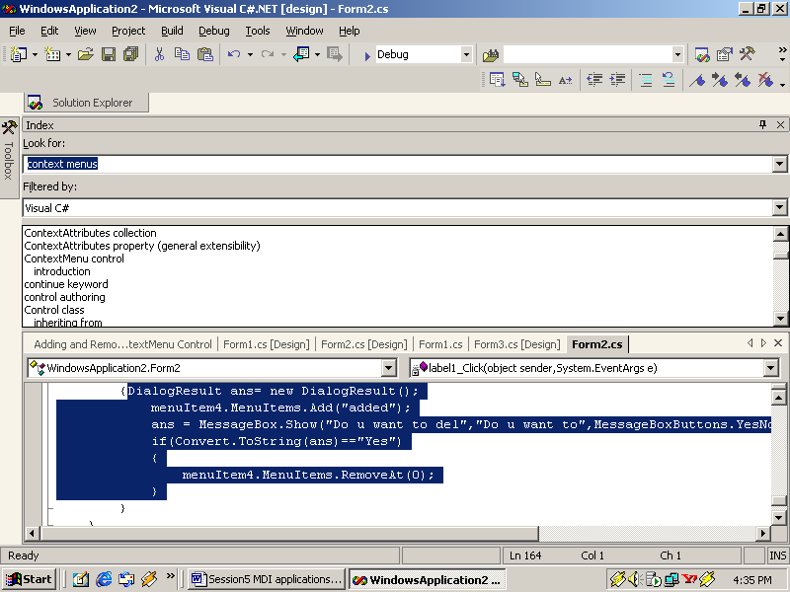
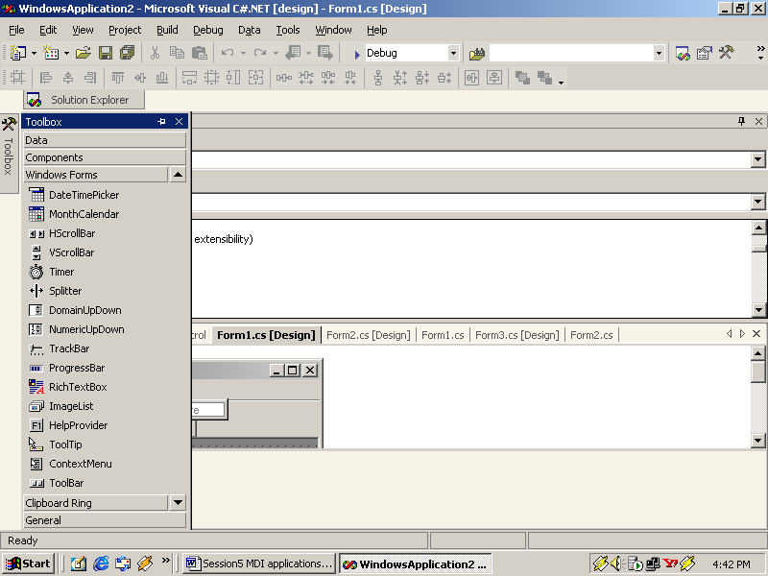
ToolBar
It is situated immediately below the menu bar
The buttons in a tool bar are analogous to the items in a menu
ToolBar control icon as in ToolBox
The different button appearance options are:
  DropDownButton
  Separator
  ToggleButton

Slide 23
ToolBar Contd…
Properties
ToolBar buttons Properties
ButtonSize
ToolTipText
Parent
DropDownArrows
PartialPush
ShowToolTips
Style
ImageIndex
Buttons
EVENTS
DropDownMenu
Wrappable
ButtonClick
ButtonDropDown

Slide 24




Mouse Events
MouseMove
MouseEnter
MouseHover
MouseUp
Mouse Down
MouseLeave

Slide 25
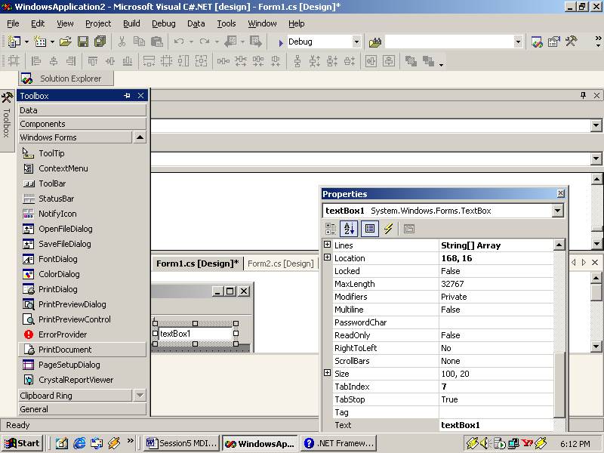
Status Bar
A StatusBar is usually displayed at the bottom of the form
A status bar can be divided into many sections called panels
StatusBar control icon as in StatusBox

Slide 26
StatusBar Contd…
StatusBar Properties
Panel Properties
Parent
ShowPanels
Panels
Style
BorderStyle

Slide 27
User Defined Dialog boxes
1
Add a new form to the project
3
Property
MaximizeBox
= false
Property
MinimizeBox
= false
2
ControlBox
= false
FormBorderStyle
= Fixeddialog

Slide 28
FolderBrowserDialog Component
Compliments the common dialog box controls provided by WinForms
Presents a modal dialog box using which you can browse through and select folders.
SelectedPath property is used to specify the path selected by user.
RootFolder Property is used to set the topmost folder in the hierarchy.

Slide 29
Summary
Single Document Interface (SDI) is made up of a single document or form, or multiple forms that are not grouped together.
Multiple Document Interface (MDI) is made up of multiple documents and all the documents are grouped together under a common interface.
The MainMenu control displays a menu at runtime.
Context menus are used to give users’ access to frequently used commands by clicking the right mouse button.
Tool bars contain tool bar buttons, which provide quick access to the most frequently used menu commands in an application.
A status bar is usually displayed at the bottom of the form. It informs the user of the status of an application.
FolderBrowserDialog component provides a modal dialog box to browse through and select folders. You can also create new folders using this component.

